Slide 1
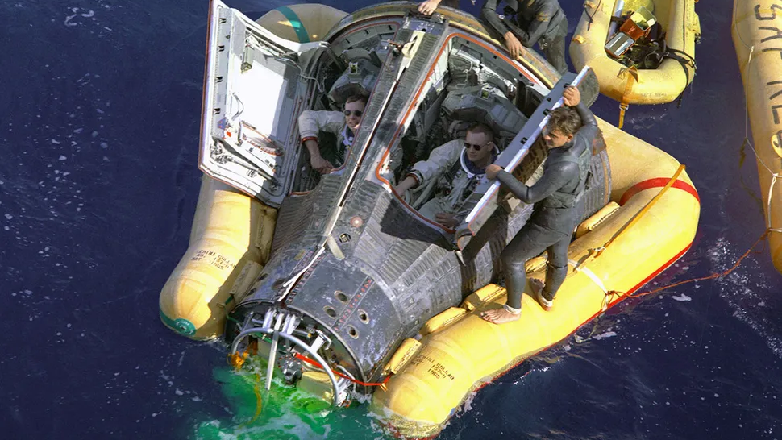
Space Human Factors
Kevin Riley
Psyc 526 Advanced Human Factors

Slide 2

Goals for this Presentation:
Summary of concepts from “Human Factors in Space Exploration” (Jones & Fiedler, 2010)
Familiarity with Space Human Factors Concepts, Key Terminology, Historical Overview of Tech
‘Career Fair’ view of skills necessary to apply for jobs in this area

Slide 3
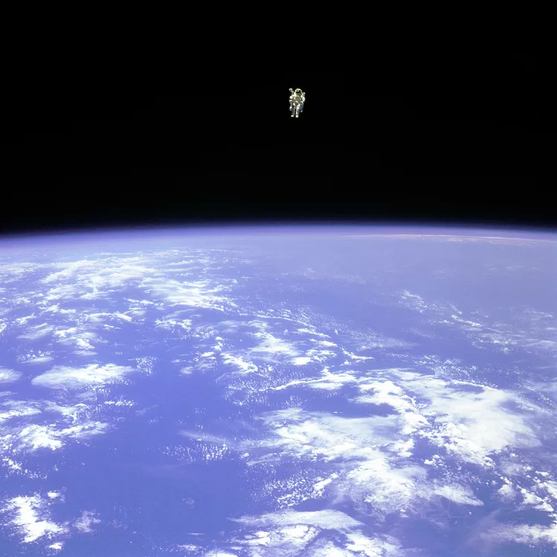
Hallmarks of the Space Environment
Gravity
Cold Temperatures/ Temp Variation
Devoid of Oxygen
Isolation(?) and Confinement
Background and solar radiation
Life Support Technologies *weight premium
Environmental closed-loop life support system (ECLSS) technologies perform such functions as managing air quality and recycling waste products into potable water.
Biofilm, viral reactivation, antibiotic resistance

Slide 4
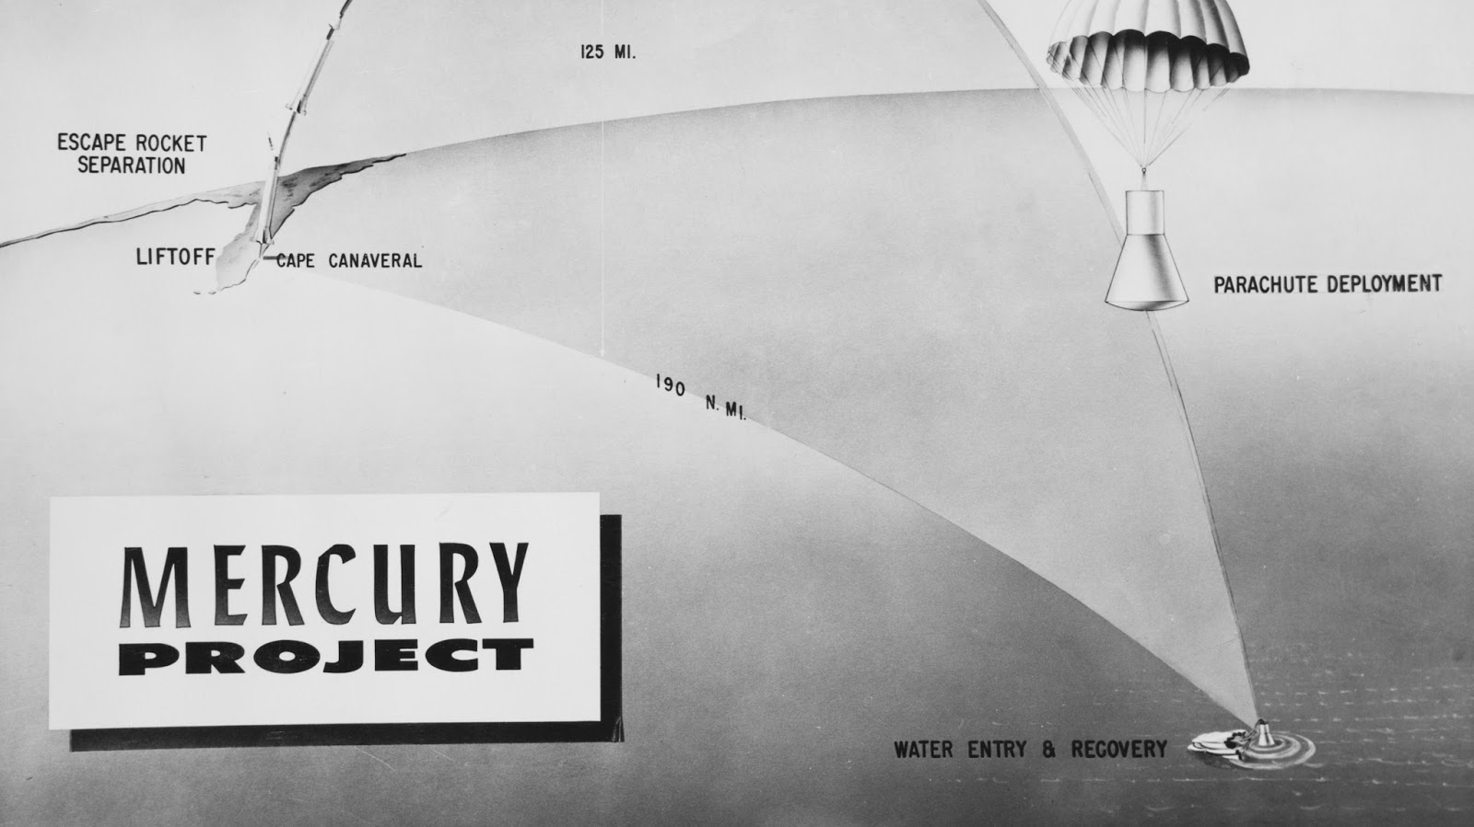
Phases of Space Ops
1. Launch & Ascent
2. On Orbit Actions*
3. Entry, Descent, and Landing (EDL)
*Karman Line

Slide 5
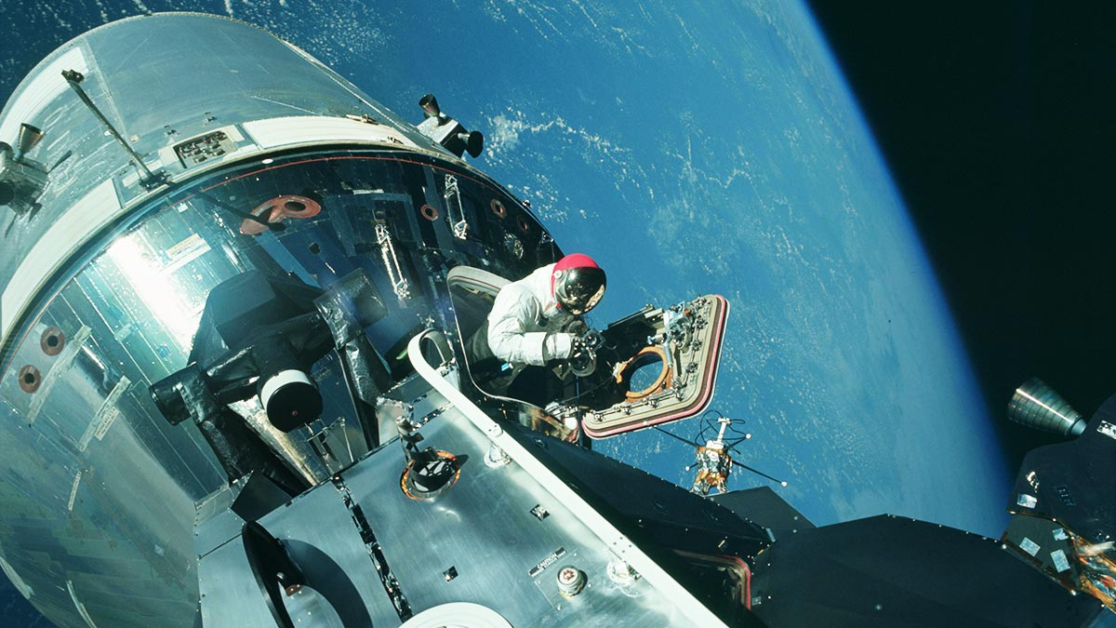

Slide 6
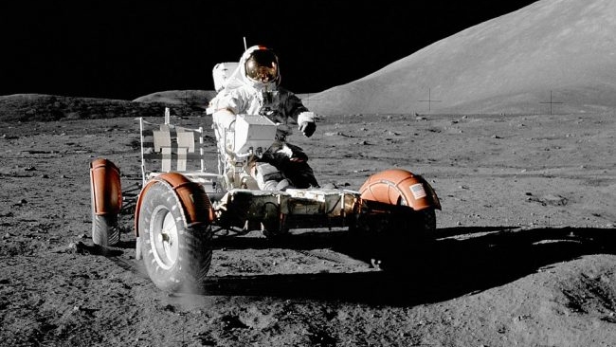
Added Phases of Space Ops
1. Outbound Transit
2. EDL to planetary/lunar surface
3. Surface Ops
4. Launch and Ascent
5. Return Transit
6. Earth EDL

Slide 7
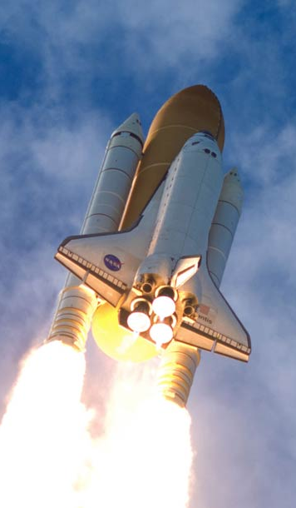
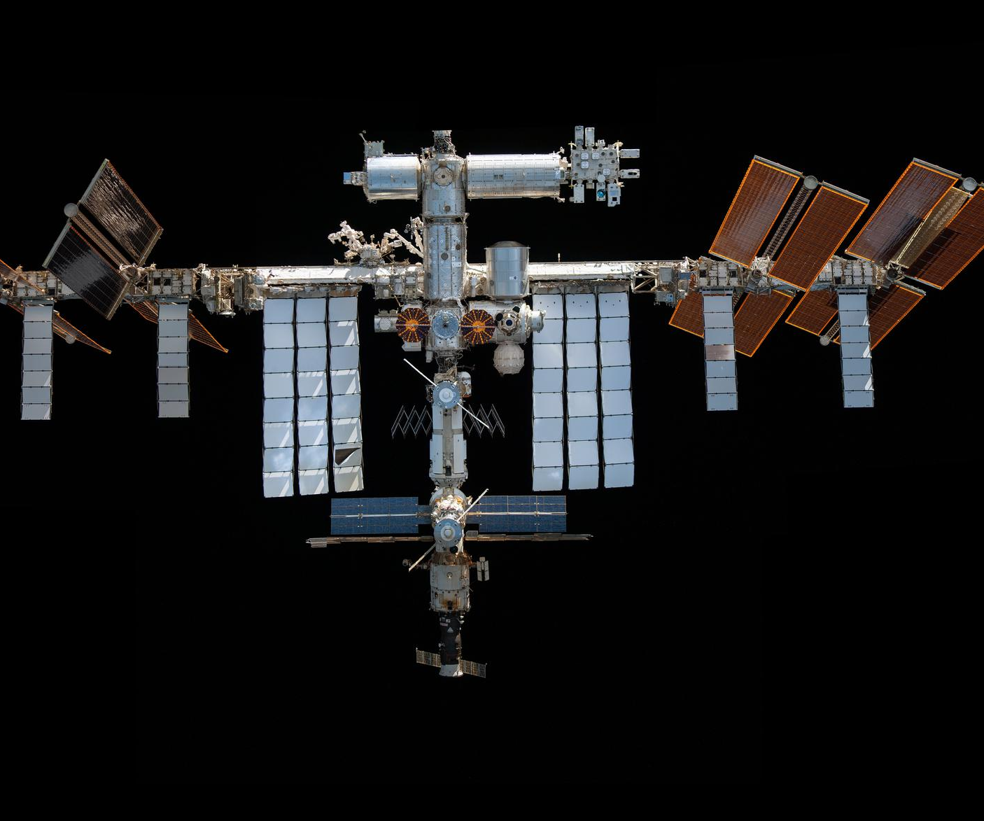

Slide 8
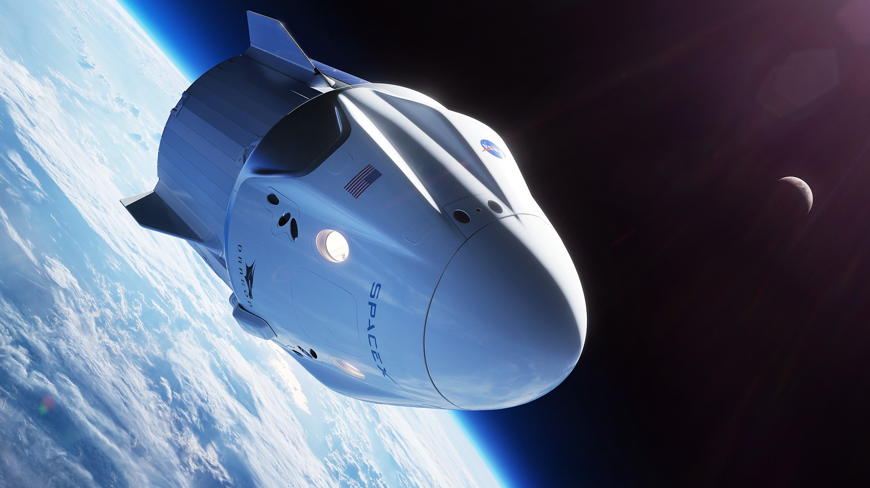

Slide 9
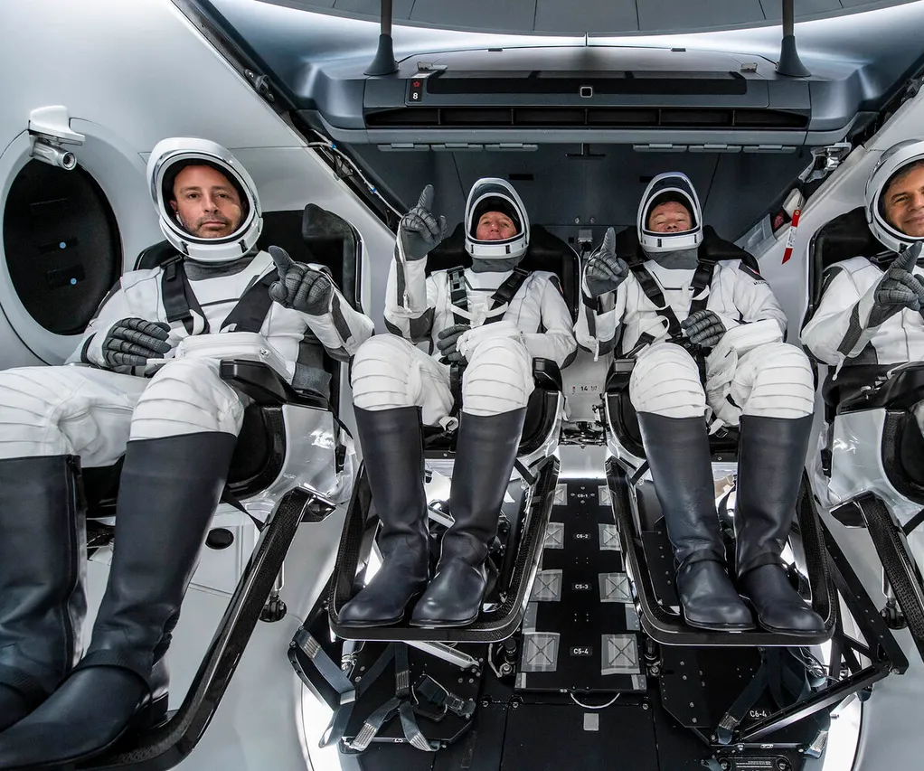
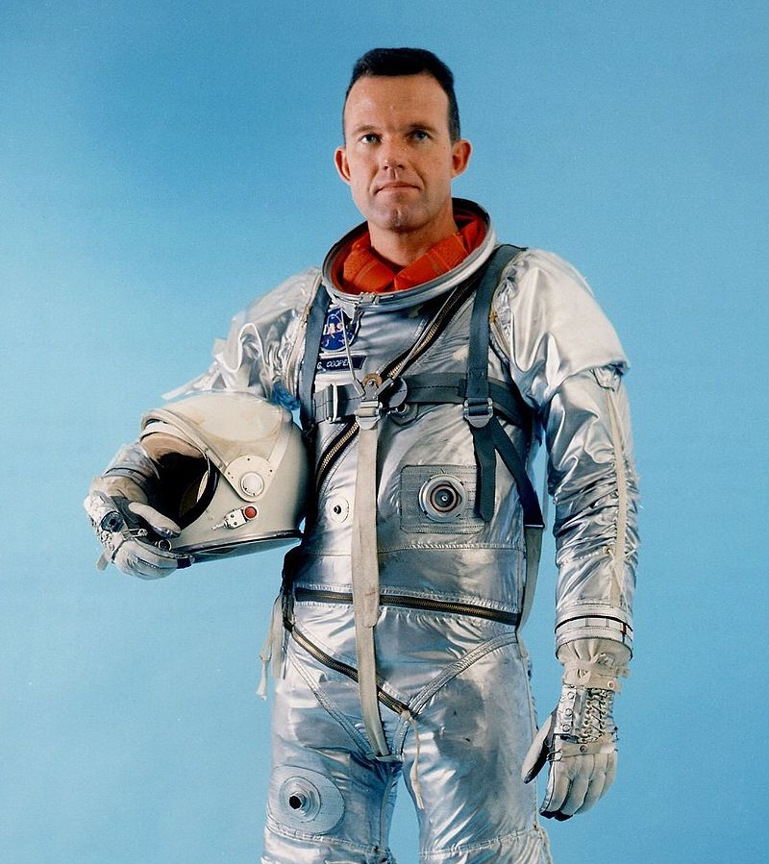
Space Flight PPE: Launch & Entry Suits (LES) Advanced Crew Escape Suit (ACES) “Get Me Downs”

Slide 10
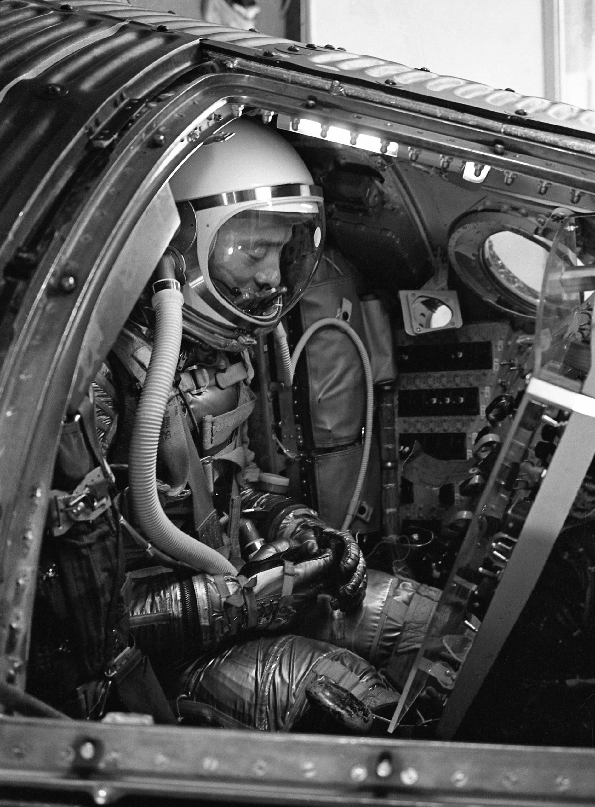

Slide 11

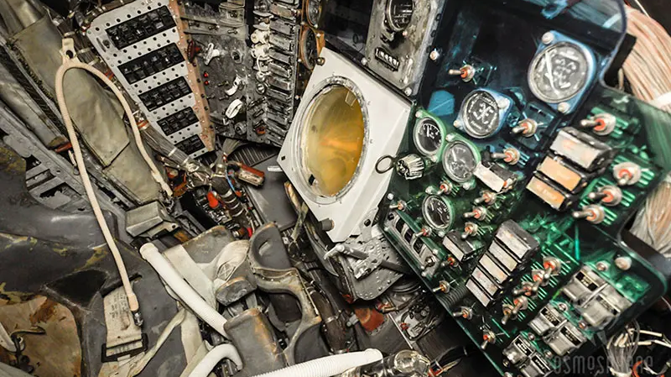

Slide 12
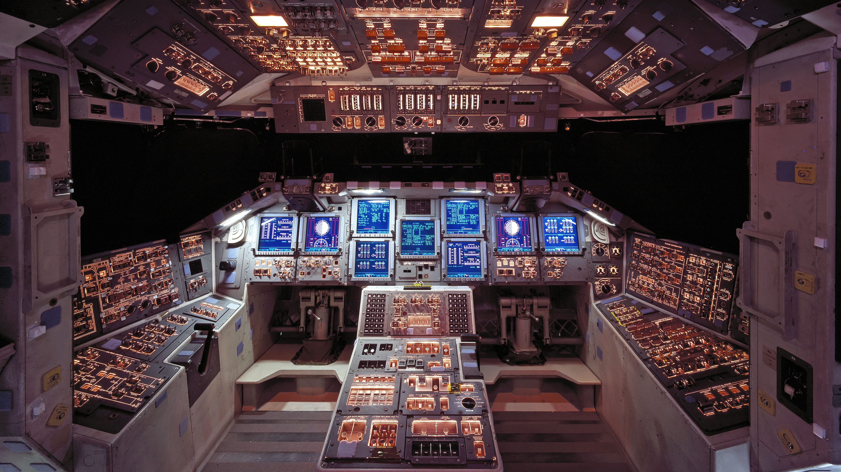

Slide 13
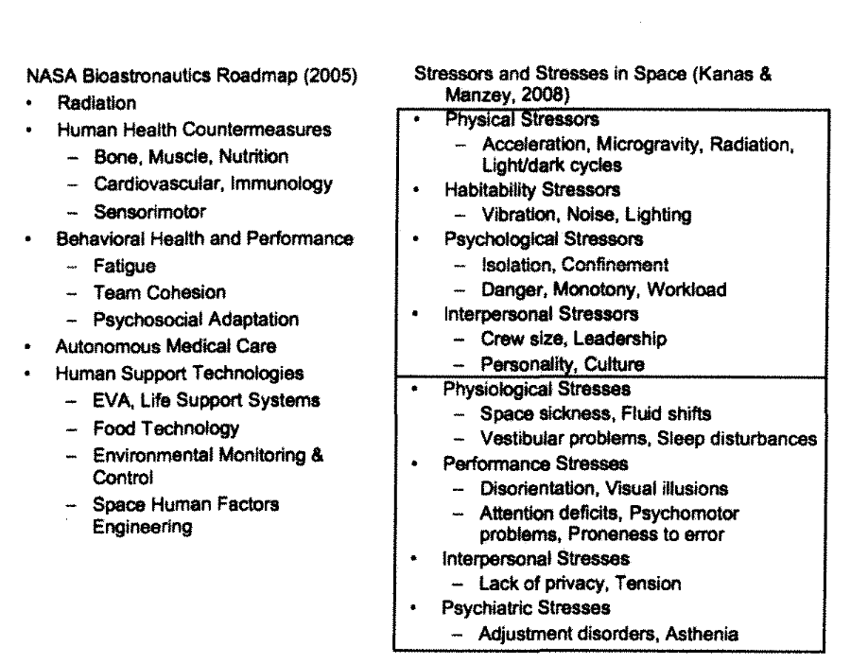
Space HF: Two overarching concerns
Crewmember Health
Task Accomplishment

Slide 14
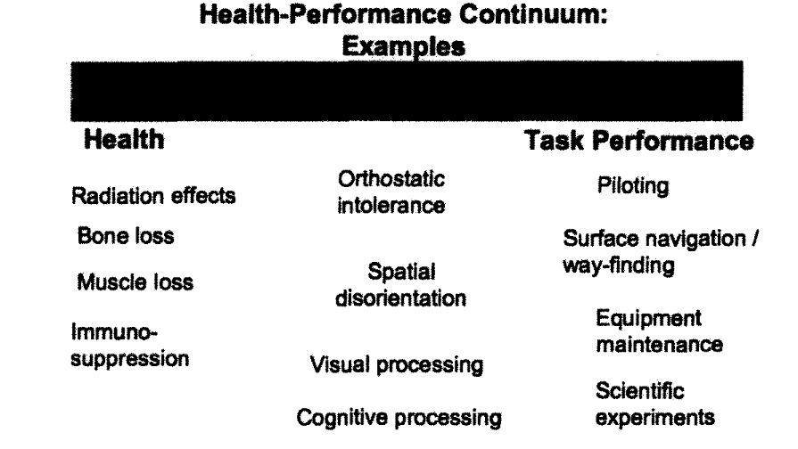

Slide 15
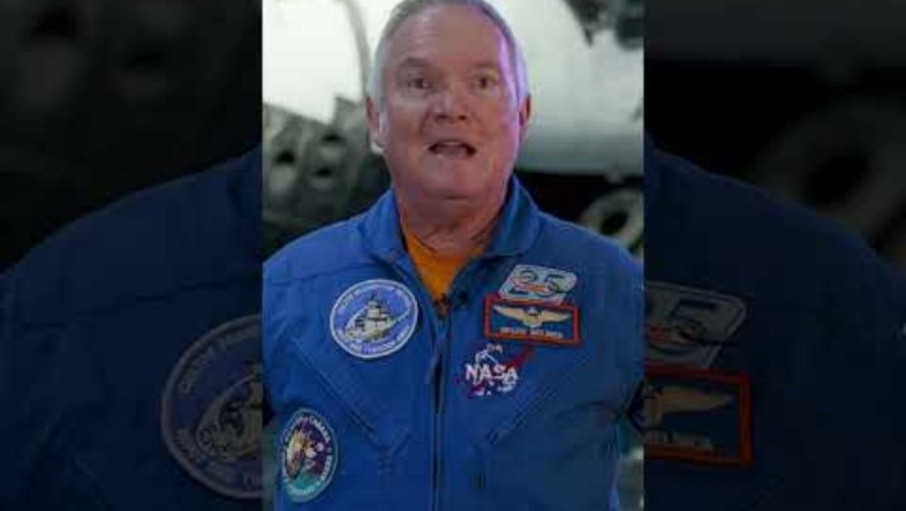
Human Performance In Space

Slide 16
HF Design Considerations: Cognitive
“Dangerous Work in a Complex Environment”
Gz acceleration can lead to A-LOC (almost loss of consciousness)
Transition between gravity/acceleration states (G-LOC )
Psychomotor vigilance test (PVT) – Dr. David Dinges U Penn
PVT- Measures fatigue and circadian effects on vigilance task (45-minute day)
“Space Stupids” or “Space Fog” increased Cognitive resources allocated to basic tasks that does get better with adjustment. (p.13)

Slide 17
HF Design Considerations: Neurovestibular
Neurovestibular – orientation through proprioceptive and vestibular systems
Weightlessness
Space motion sickness (SMS) (microgravity & acceleration 2-3 days)
Temporary Perceptive Deficits (first few days of adjustment- screen perception, hand eye coordination, HCI, (p.9)
Scheduling key mission tasks after adjustment period
G- transition periods- vestibulo ocular reflexes (VOR)& visual illusions (target acquisition tasks). *Egress Design
Errors in smooth eye pursuit, and hand coordination tasks
Vibration intensity, duration and frequency = worse overall performance

Slide 18
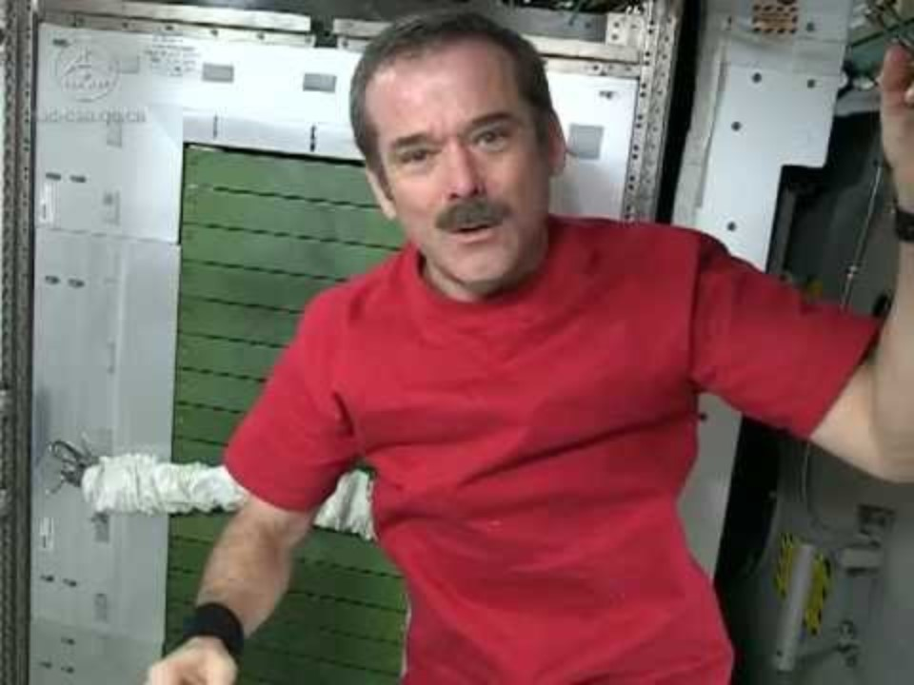

Slide 19
HF Design Considerations: Musculo-Skeletal
Requires HF Engineering (p.11)
Bone density decreases
Muscular deterioration in legs and trunk especially
Exercise helps reduce effects

Slide 20
HF & Behavioral Health (HFBP) Design
View through the lens of mission endurance
(short vs long term)
NASA maintains psychiatrists and psychologists in team, including OpPsych group. Pre-flight training for crews.
Provides outlets for astronauts to maintain family and interpersonal connections
(phone, HAM radio, email)
Future environments likely to be noisy, crowded, and reduced privacy. (p.14)
Multicultural considerations of international missions
(language, culture, spiritual practices)

Slide 21
I/O Approach to Long Duration Spaceflight Design- Galarza et al. (1999)
Performance Under Stressful Conditions
Mental/Emotional Stability
Judgment & Decision Making
Teamwork Skills (people & robot human interaction)
Conscientiousness
Family Issues
Group Living Skills
Motivation & Communication Skills
Leadership

Slide 22
Future HF Topics from Article
HCI
Ergonomics
Multilevel Modeling
(physio/psycho/social/task performance modeling)
Human Systems Integration HSI
Contemporary HF projects*

Slide 23
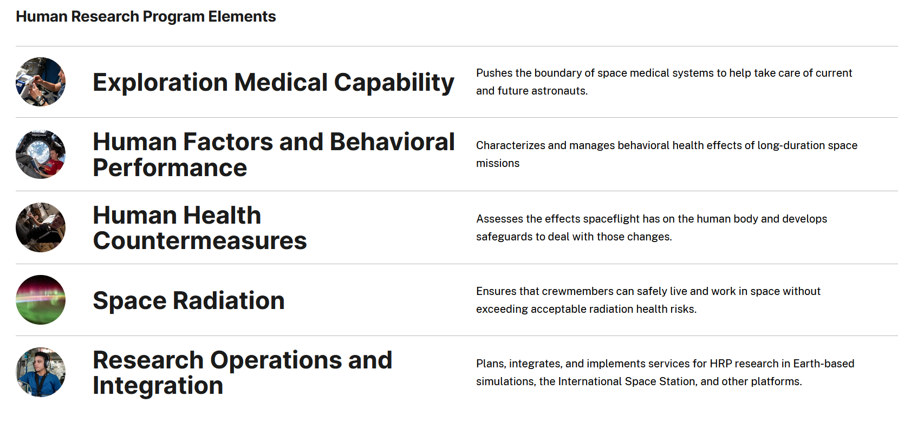

Slide 24
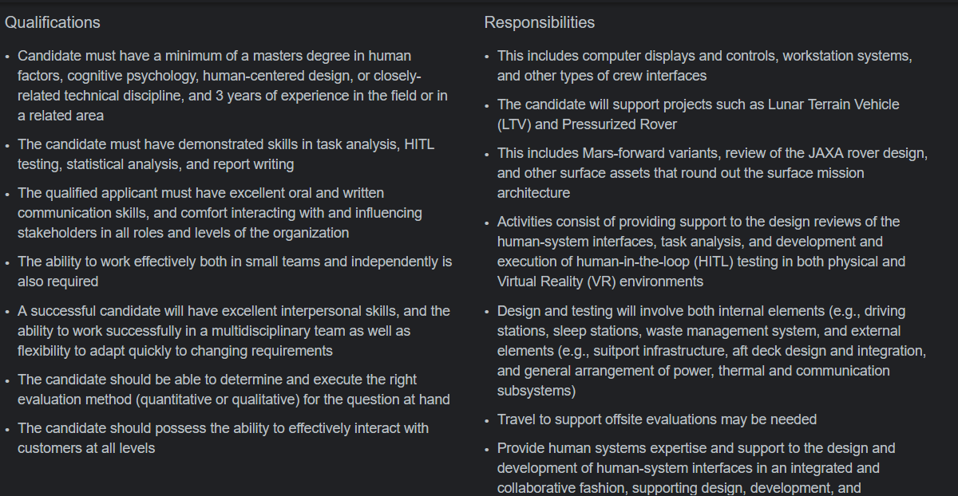
Skills and Qualifications- Hiring

Slide 25
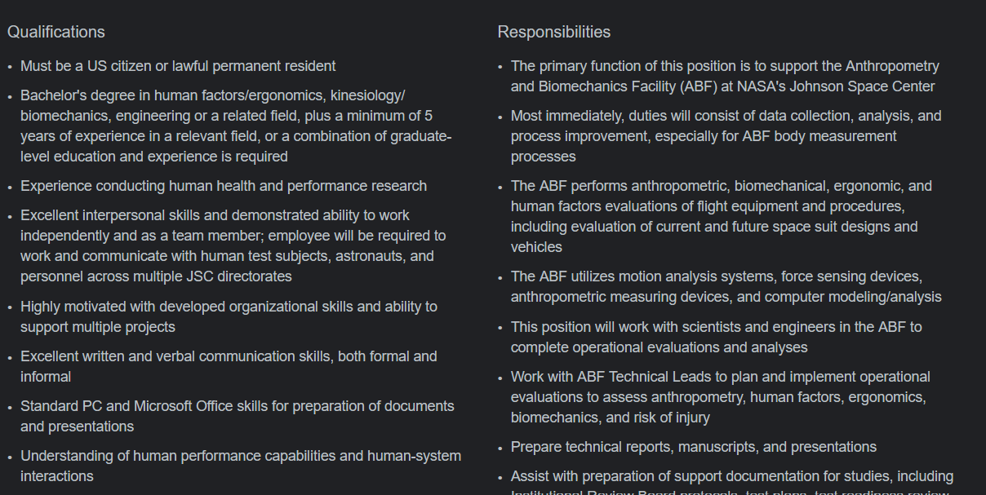

Slide 26
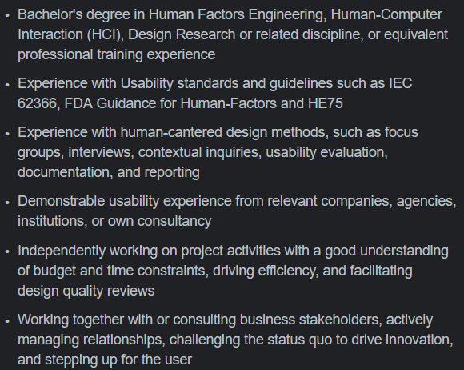

Slide 27
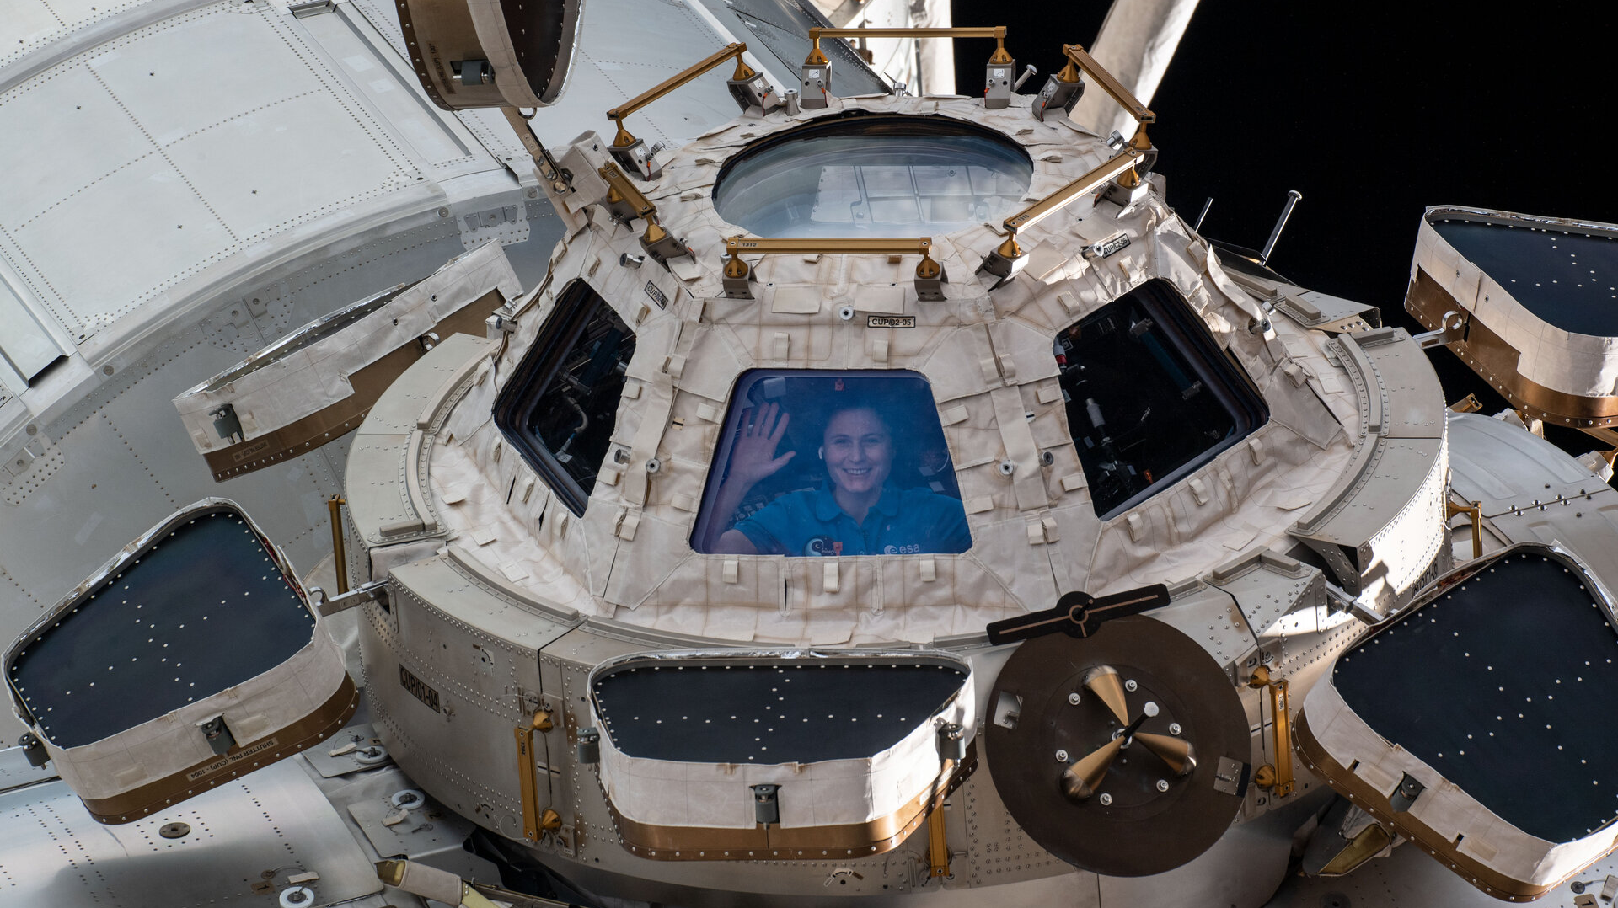
Questions & Comments

